Slide 1
Euclid saves us from ignorance
Kosmos session: March 10, 2023

Slide 2
Euclid . . .
. . . is most to be admired for his Elements of Geometry because of the choice and arrangement of the theorems and problems made with regard to the elements. For he did not include all that he might have included, but only those theorems and problems which could fulfil the functions of elements .... If you seek to add or subtract anything, are you not unwittingly cast adrift from science and carried away toward falsehood and ignorance?
(Proclus Diadochus’ Commentary on Euclid’s Elements, 5th century CE)

Slide 3
Famous beginnings
Μῆνιν ἄειδε θεά . . . Homer, Iliad, “Sing goddess of the wrath . . .”

Slide 4
Famous beginnings
Μῆνιν ἄειδε θεά . . . Homer, Iliad, “Sing goddess of the wrath . . .”
῎Ανδρα μοι ἔννεπε Μοῦσα . . . Homer, Odyssey, “Τell me, Muse, of the man . . .”

Slide 5
Famous beginnings
Μῆνιν ἄειδε θεά . . . Homer, Iliad, “Sing goddess of the wrath . . .”
῎Ανδρα μοι ἔννεπε Μοῦσα . . . Homer, Odyssey, “Τell me, Muse, of the man . . .”
Σημεῖόν ἐστιν, οὗ μέρος οὐθέν. Euclid, Elements, “A point is (that) of which (there is) no part.” (Book 1, definition 1)

Slide 6
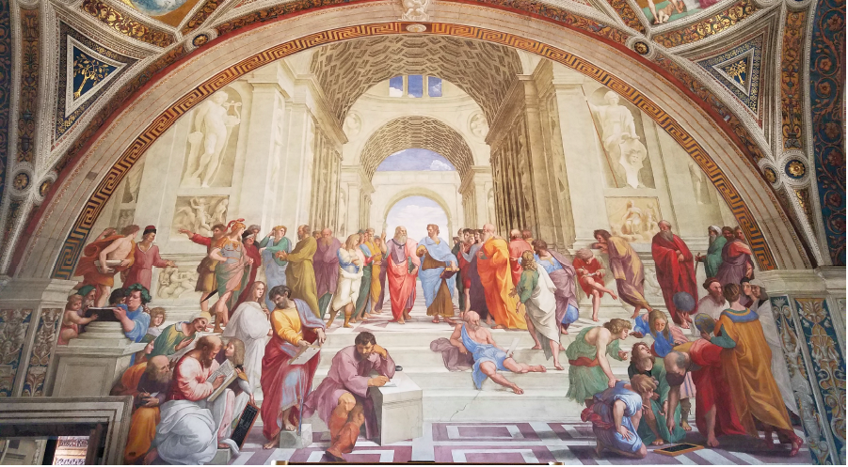
Raphael’s School of Athens, the Vatican

Slide 7
Raphael’s School of Athens, the Vatican
Pythagoras and his chalkboard
Euclid and his chalkboard

Slide 8
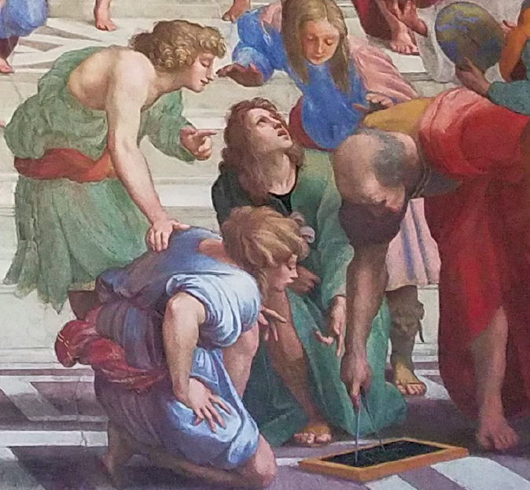

Slide 9
Close-up of Euclid’s chalkboard

Slide 10
Definition 15
ιε ́ Κύκλος ἐστὶ σχῆμα ἐπίπεδον ὑπὸ μιᾶς γραμμῆς περιεχόμενον [ἣ καλεῖται περιφέρεια], πρὸς ἣν ἀφ᾽ ἑνὸς σημείου τῶν ἐντὸς τοῦ σχήματος κειμένων πᾶσαι αἱ προσπίπτουσαι εὐθεῖαι [πρὸς τὴν τοῦ κύκλου περιφέρειαν] ἴσαι ἀλλήλαις εἰσίν.
15 A circle is a plane figure contained by a single line [which is called a circumference], (such that) all of the straight-lines radiating [towards the circumference] from a single point lying inside the figure are equal to one another.

Slide 11
Αἰτήματα (postulates)
α ́ ᾽Ηιτήσθω ἀπὸ παντὸς σημείου ἐπὶ πᾶν σημεῖον εὐθεῖαν γραμμὴν ἀγαγεῖν.
1. Let it be postulated to draw (“lead”) a straight line from any point to any point. Thus a straightedge (unmarked ruler) is permitted.

Slide 12
Αἰτήματα (postulates)
α ́ ᾽Ηιτήσθω ἀπὸ παντὸς σημείου ἐπὶ πᾶν σημεῖον εὐθεῖαν γραμμὴν ἀγαγεῖν.
1. Let it be postulated to draw (“lead”) a straight line from any point to any point. Thus a straightedge (unmarked ruler) is permitted.
γ ́ Καὶ παντὶ κέντρῳ καὶ διαστήματι κύκλον γράφεσθαι.
3. And to draw a circle with any center and radius. Thus a pair of (collapsible) compasses is allowed.

Slide 13
Κοιναὶ ἔννοιαι (common notions)
α ́ Τὰ τῷ αὐτῷ ἴσα καὶ ἀλλήλοις ἐστὶν ἴσα.
1. Things equal to the same thing are also equal to each other.
If a = c and if b = c, then a = b. (The “same thing” is c)

Slide 14
Κοιναὶ ἔννοιαι (common notions)
β ́ Καὶ ἐὰν ἴσοις ἴσα προστεθῇ, τὰ ὅλα ἐστὶν ἴσα.
2. And if equal things are added to equal things, the wholes are equal.
If a = b, and if c = d, then a + c = b + d.

Slide 15
Euclid’s 5th Postulate
(αἴτημα ε´)
5. And that if a straight-line falling across two (other) straight-lines makes internal angles on the same side (of itself whose sum is) less than two right-angles, then the two (other) straight-lines, being produced to infinity (ἐπ᾿ ἄπειρον “boundless, limitless”), meet on that side (of the original straight-line) that the (sum of the internal angles) is less than two right-angles (and do not meet on the other side).‡
‡ This postulate effectively specifies that we are dealing with the geometry of flat, rather than curved, space.

Slide 16
ἄπειρος and τὸ ἄπειρον (outside Euclid)
Note that Greek ἄπειρος is synonymous with Latin infinitus, both with the meaning “not limited.”
Also I read a couple of days ago a review of a new book by author Carlo Rovelli about Anaximander and his theory of the “apeiron” (unlimited) as the first principle of nature: Anaximander and the nature of science.

Slide 17
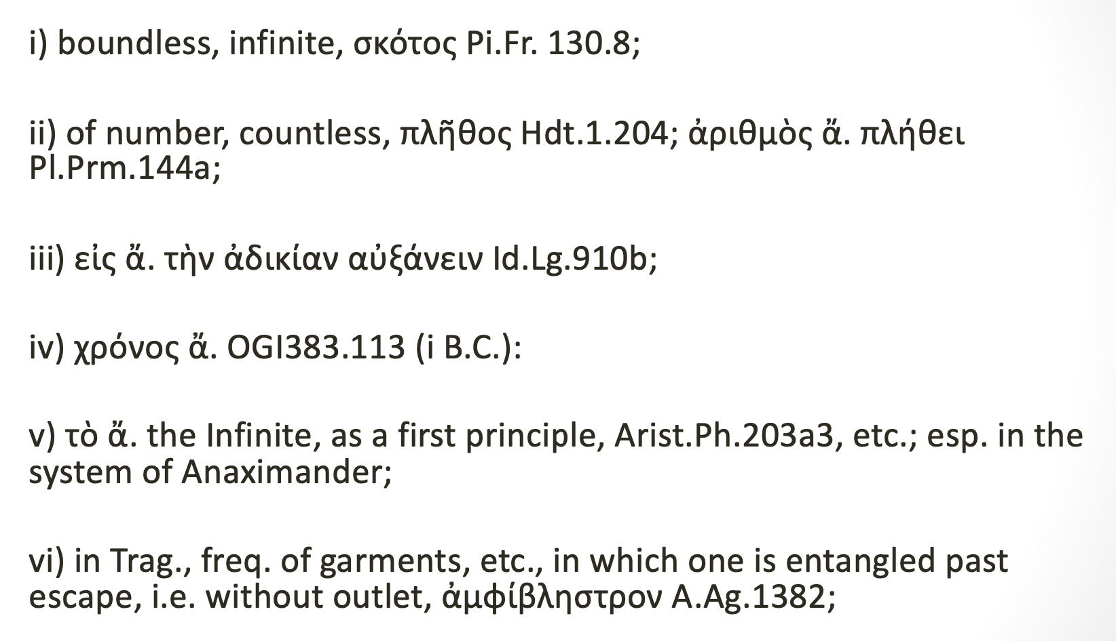
ἄπειρος and τὸ ἄπειρον (outside Euclid)

Slide 18
Greek number system (2nd)
Note: there are 24 letters in the “regular” Greek alphabet; but 27 were needed to have a working system of 1-9, 10-90, and 100-900. So three obsolete letters were kept just for mathematical purposes, even though they weren’t being used anymore for writing.

Slide 19
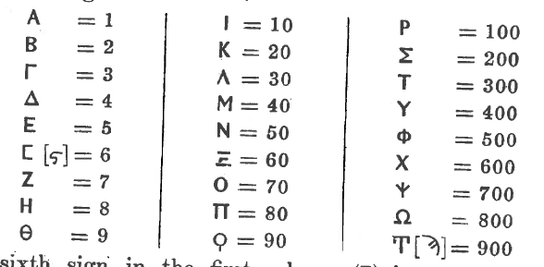
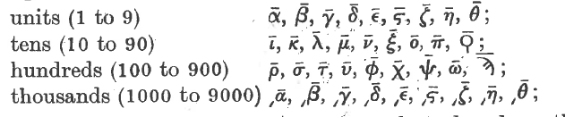
Heath page 32
Heath page 37

Slide 20
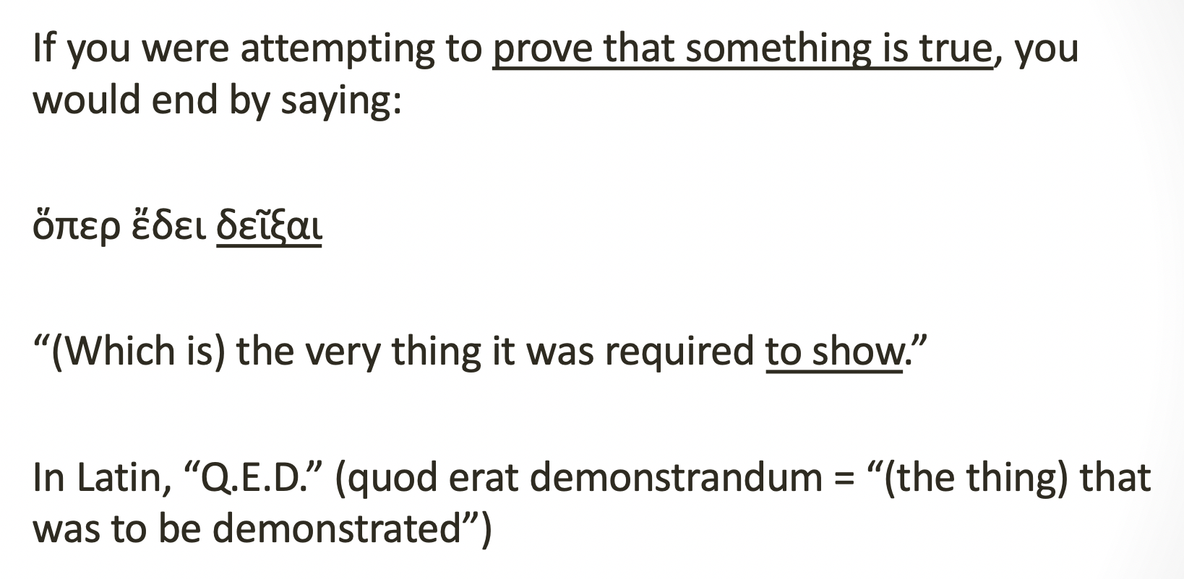
Ending a proof 1

Slide 21
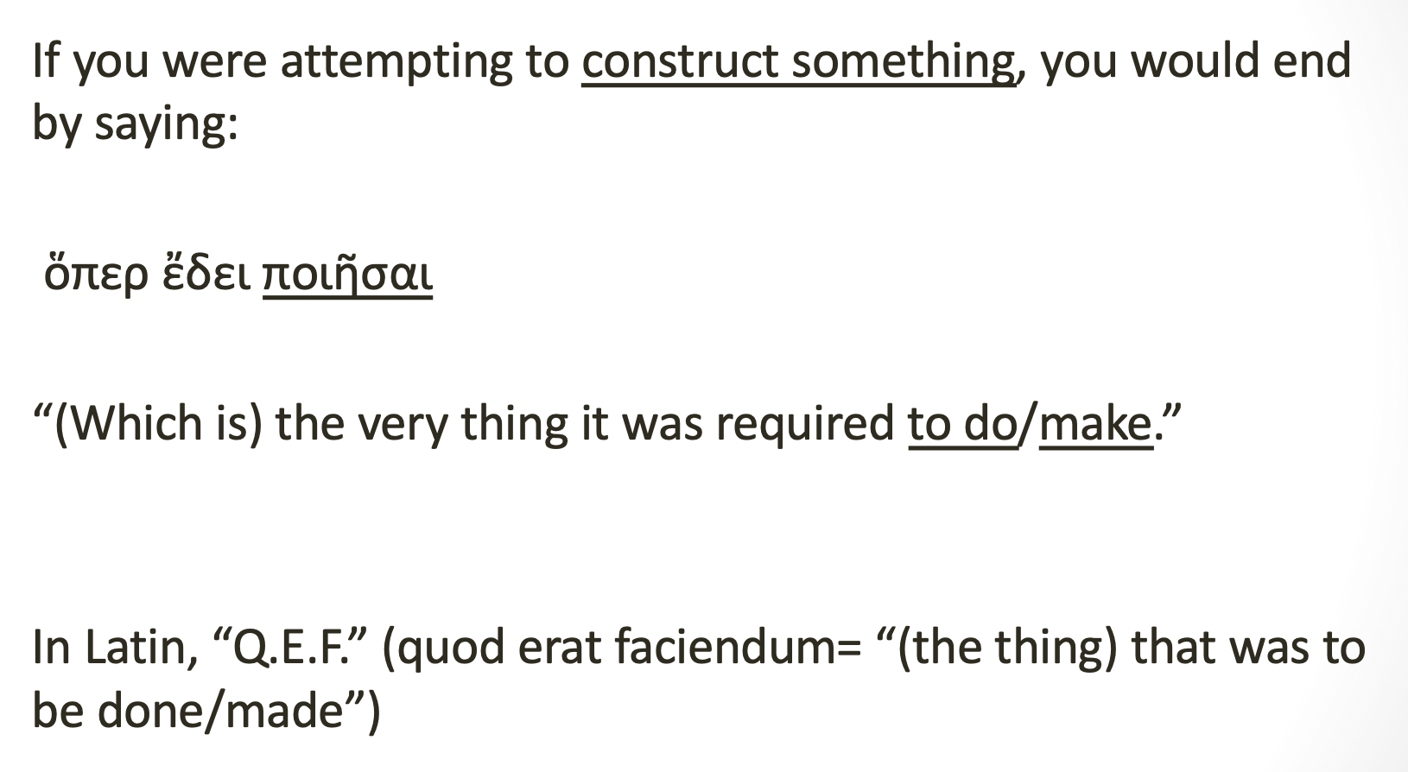
Ending a proof 2

Slide 22
Parts of a Proposition
(see Heath volume I, pages 370ff.)
1. πρότασις “enunciation”
2. ἔκθεσις “setting-out”
3. διορισμός “definition/specification”
4. κατασκευή “construction”
5. ἀπόδειξις “proof”
6. συμπέρασμα “conclusion”

Slide 23
Proposition I.1
Ἐπὶ τῆς δοθείσης εὐθείας πεπερασμένης τρίγωνον ἰσόπλευρον συστήσασθαι.
On the given finite straight line, to set up (construct) an equilateral triangle.

Slide 24
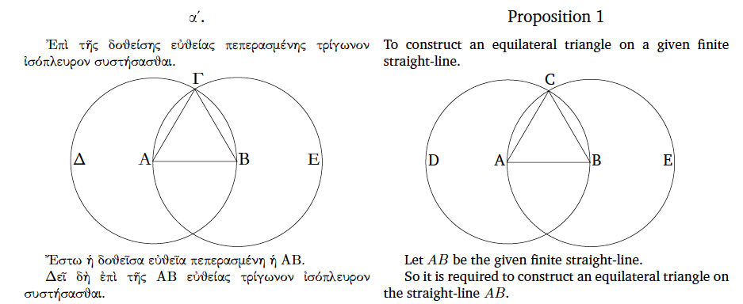
Euclid Proposition I.1

Slide 25
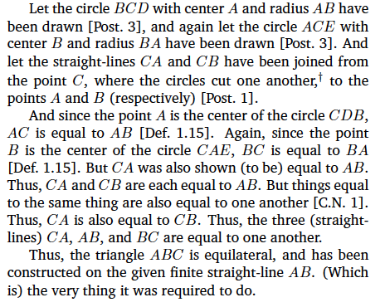
Euclid I.1 . . .

Slide 26
Euclid I.1 on (virtual) whiteboard

Slide 27
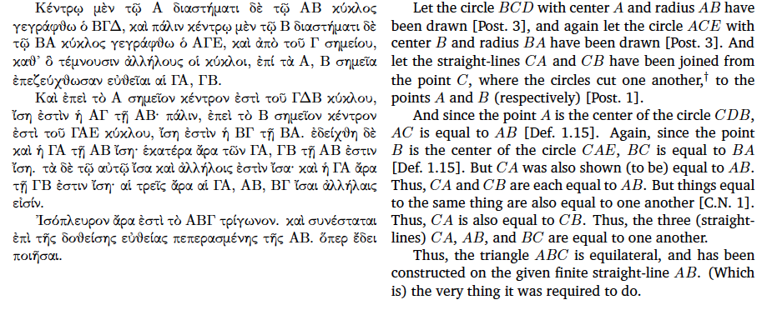
Euclid I.1; and the footnote . . .

Slide 28
Euclid I.1; and the footnote . . .
† The assumption that the circles do indeed cut one another should be counted as an additional postulate. There is also an implicit assumption that two straight-lines cannot share a common segment.

Slide 29
Euclid I.1; and the verb . . .
γεγράφθω: 3rd person singular, perfect imperative passive verb.

Slide 30
A 1000-year-old manuscript of Euclid’s Elements
Greek Vatican Manuscript 190
Discovered in 1808 by F. Peyrard, a Frenchman, in the library of the Vatican. At the time, Napoleon was collecting manuscripts from Italy and sending them back to Paris.
This manuscript, a copy of Euclid carefully written by hand in the 10th Century A.D., contains all thirteen books of the Elements as well as some commentary and some other mathematical works formerly attributed to Euclid.

Slide 31
Source: See page 15r in the viewer at this link:
https://digi.vatlib.it/view/MSS_Vat.gr.190.pt.1

Slide 32
In conclusion, remember Proclus’ comment
By choice Euclid was a follower of Plato and connected with this school of philosophy. In fact he set up as the goal of the Elements as a whole the construction of the so-called Platonic figures (tetrahedron, cube, octahedron, dodecahedron, icosahedron).

Slide 33
Proposition XIII.16
(the antepenultimate Proposition😊)
Εἰκοσάεδρον συστήσασθαι καὶ σφαίρᾳ περιλαβεῖν . . .
To construct an icosahedron, and to enclose (it) in a sphere . . .

Slide 34
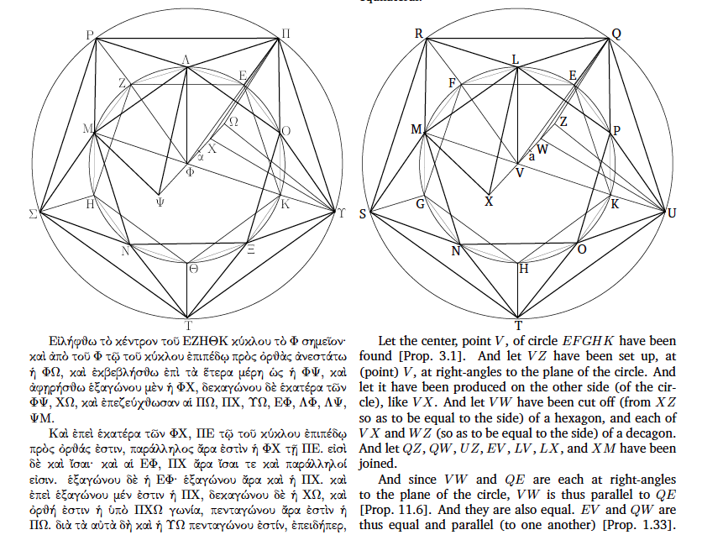

Slide 35
Ευχαριστώ!
Thank you!
(Some references to T. L. Heath, History of Greek Mathematics, vol. 1)

